Slide 1

ARTIFICIAL EYES TO VISUALLY IMPAIRED
(Sponsored by KSCST, Bengaluru)
Project Reference No.: 45S_BE_1183
Sanctioned Budget: INR 6000
SAMBHRAM INSTITUTE OF TECHNOLOGY
M.S.Palya, Bangalore-560097
Department of Computer Science and Engineering
Student(s) Name:
1. Toran Shrestha
2. Soman Kumar Yadav
3. Yogesh Chaudhary
4. Satis Kumar Chaudhary
Under the Guidance of:
Asst. Prof. Mr. Hanumantha Rao K.R.

Slide 2
OBJECTIVES
Our main aim is to combine all different tasks such as speech recognition, text translation, text synthesis and text extraction from image all embedded in one so that we get a user-friendly application.
Literacy rate increases since disabled people also gets chance to learn and graduate their college.
In Addition, Language barrier gets broken since, we can also include language conversion in our system interface.

Slide 3
METHODOLOGY
Image Acquisition: takes input as file in jpg, png format or Captures image from the built-in camera. The Quality of the image captured depends on the camera used.
Image Processing: The uploaded image goes to image-processing module where resizing, noise removal, normalization, grayscaling, thresholding is performed for better Accuracy.

Slide 4
METHODOLOGY
Cont.…
Image to text conversion: The processed image is passed to Tesseract ocr which is trained using images with text which converts the image into text.
Language Translator: Text is converted to desired language using Google Trans.
Voice processing Module: Voice processing module changes the converted text into sound and processes it with specific physical characteristics so that the sound can be understood. We have used Google-Text-to-Speech(gTTS) for audio output.

Slide 5
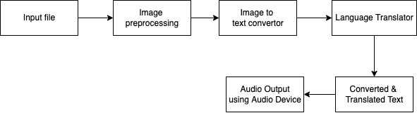
WORK PLAN

Slide 6
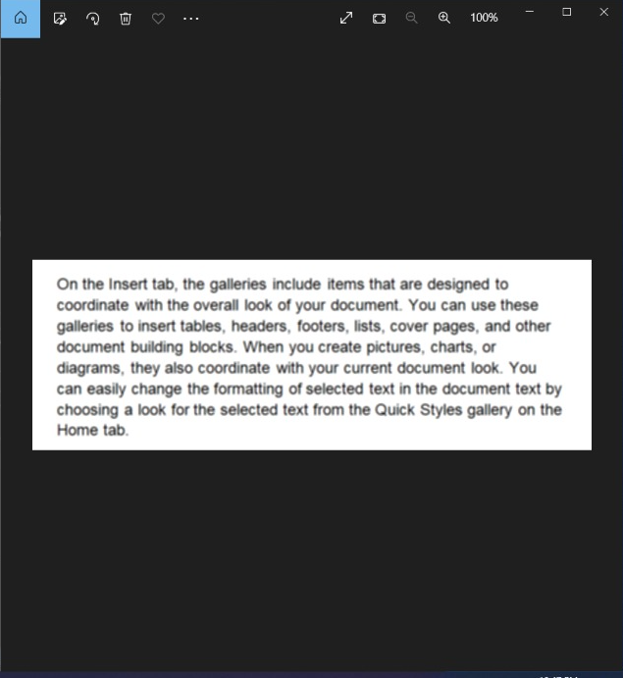

SUMMARY OF PROGRESS (DESIGN, EXPERIMENTS, RESULTS)
Image with Blurred Text
Output

Slide 7
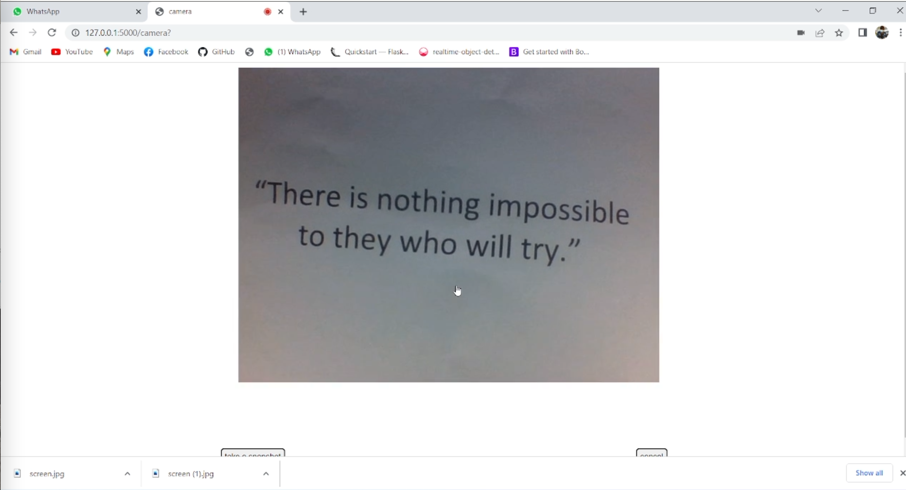
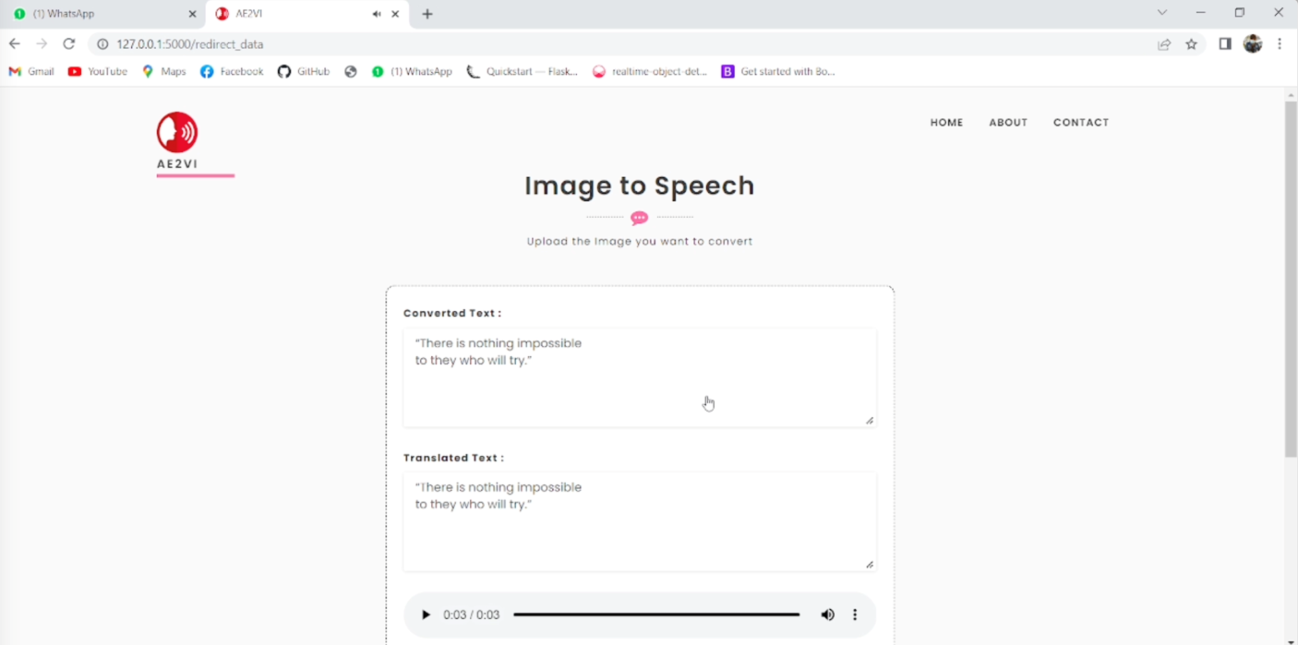
SUMMARY OF PROGRESS (DESIGN, EXPERIMENTS, RESULTS)
Capturing image using Camera
Output

Slide 8
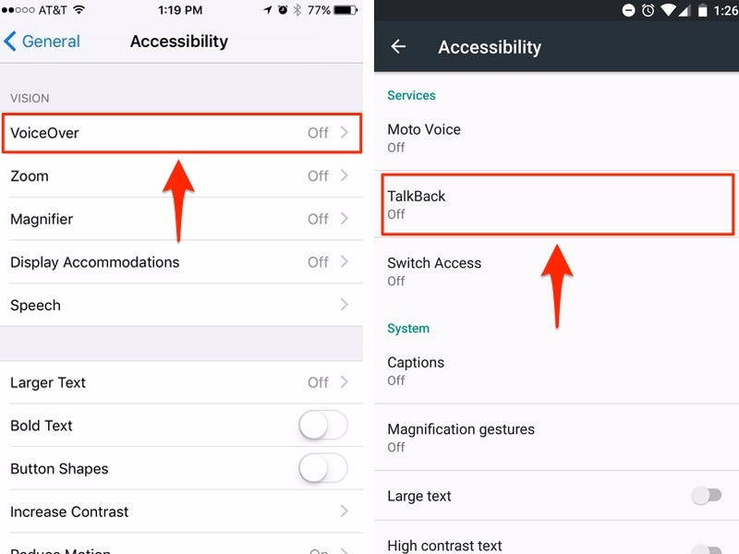
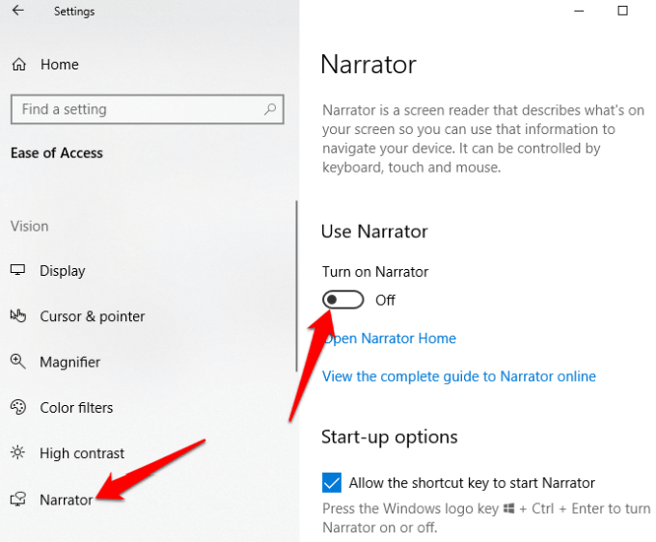
SUMMARY OF PROGRESS (DESIGN, EXPERIMENTS, RESULTS)
Accessibility Feature in IOS
Accessibility Feature in Android
Accesibilty Feature in Windows

Slide 9
SCIENCE & TECHNOLOGY COMPONENT / INNOVATIVENESS / NOVELTY OF THE PROJECT
SCIENCE & TECHNOLOGY COMPONENT:
OpenCV, Python, Flask, Tesseract OCR, Google Translate, gTTS,
INNOVATIVENESS:
User can use in their own smartphone with internet connection.
Easy to use and understand.
User can convert in image text to desired language.
User can listen to voice speech in desired language.
NOVELTY:
Image processing: For improving Tesseract OCR Accuracy we have followed preprocessing methods as
resizing, noise removal, normalization, grayscaling, thresholding.
Training Tesseract with Images with Blur Text: We have trained on blur images by applying a gaussian blur filter and tuned for better recognition of blur text in an image.

